Slide 1
Department of Global Public Health
Karolinska Institutet

Slide 2
Global Public Health
Multidisciplinary department
Global and population perspective
How societal phenomena affect public health and how to prevent them
Focus on vulnerable groups and health equity
Photo: Getty Images
Notes:
The Department of Global Public Health is a multidisciplinary department with the aim to advance knowledge about challenges and opportunities for public health in a local, national, and global setting. This includes studying how societal phenomena affect health in a globalized world and translating research evidence into public health action.
In line with Karolinska Institutet’s vision, we strive towards better health for all, and we give special attention to the needs of the most vulnerable populations.

Slide 3
"We emphasise the importance of global awareness"
Marie Hasselberg, Head of the Department
Notes:
We aim to be in the forefront of global public health research and education in Sweden, as well as an important international collaborative partner.
Both our research and education are focused on how different societal and individual factors affect population health, socioeconomic consequences of poor health and the need for a systems-based approach to equitable and sustainable population health.
As a university, we have a critical role in the achievement of the United Nations’ Sustainable Development Goals, and as a department we emphasise the importance of global awareness and responsibility within both our research and our education.
Our education programmes prepare health experts to confront the global burden of disease. Many of our researchers are enga-ged in the wider community and often participate as scientific advisors in regional, national and international expert groups.
Our aim is to create a good psychosocial working environment that facilitates scientific discussions and critical reflection.
Marie Hasselberg

Slide 4
GPH staff
Employees
140
Professors
16
(53% women)
Affiliated researchers
170
Assistant professors
7
PhD Students
119 (60% women)
Senior Lecturers
3
Notes:
140 Employees
170 Affiliated researchers
119 PhD students (60% women)
16 Professors (50% women)
7 Assistant professors
3 Senior Lecturers
12 Principal/senior reseachers
53 Associate Professors (Docenter)
53 aktiva docenter anställda och anknutna
33 av dessa är lektorer eller professorer
14 postdocs

Slide 5
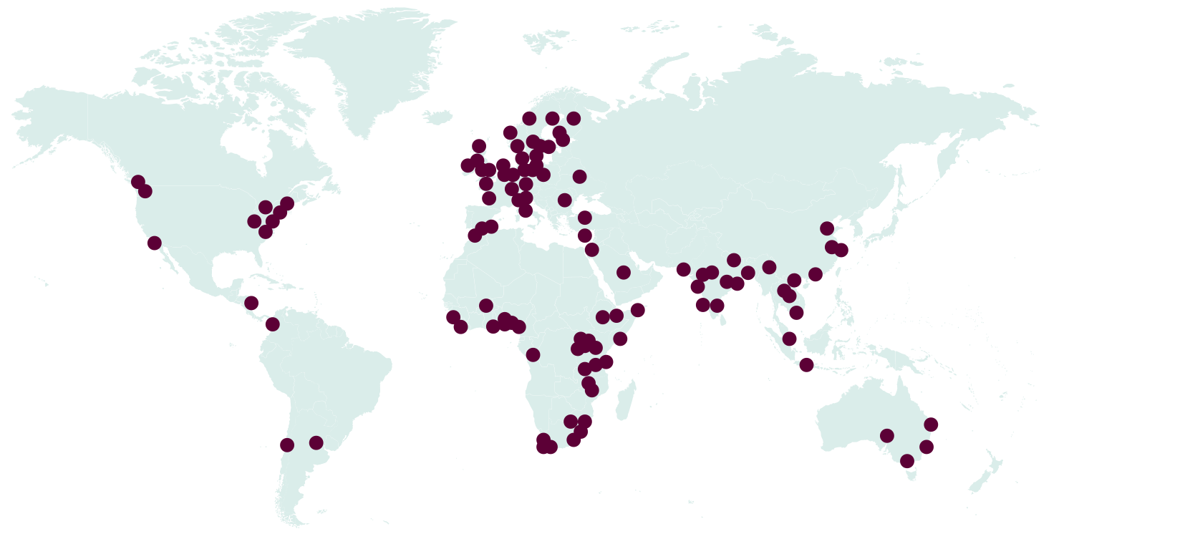
Colleagues and collaborations around the world
Notes:
We collaborate in research and education with partners all over the world, including universities, public health agencies, civil society, and patient organisations
Engaged in policy work and as experts
Our researchers continuously engage in the formulation of policy documents about public and global health challenges, for example policy briefings and guidelines produced by national agencies and the WHO. We also write textbooks and popular science publications in weekly and monthly magazines.
Many researchers at our department contribute with their expertise to multilateral organisations such as the UNICEF and the WHO. They act as temporary advisors, members of expert committees or external experts in national research councils and organisations. We intervene in acute disaster and epidemic situations, either by preparing people before they occur or by providing support ourselves on site.
Close collaboration with public health services in Region Stockholm
We collaborate closely with the local public health services in Region Stockholm, who provide an important infrastructure with local data. Several of our employees have joint appointments at the department and at Region Stockholm.
We communicate our research to the public
We value close contact with the public at large and offer public lectures. We arrange Stockholm Public Health Lectures in collaboration with the Centre for Epidemiology and Community Medicine, Region Stockholm. The lecture series focuses on key topics in the area of public health, as well as issues that concern the planning and commissioning of health care.
We give presentations at international, national, and regional stakeholder conferences, cooperate with many patient organisations, and engage with the media to discuss and debate current issues.

Slide 6
Our research
12 research groups
Local to Global, from Region Stockholm to WHO
Interrelated disciplines
Global Health
Social Medicine
Public Health Epidemiology
Improvement of population health

Slide 7
Notes:
Research expertise and aims
Our researchers have expertise in Global Health, Social Medicine and Public Health Epidemiology. A broad range of research methods are utilised, both quantitative and qualitative, and often in combination.
Our research aims to promote equitable and sustainable population health by producing new knowledge to aid the planning, implementation and evaluation of health systems and public health practice. We contribute to evidence-based guidance and recommendations by generating new knowledge of the impact of societal structures, health systems, organisations, and individual health behaviours on health, as well as by highlighting priority areas for public health interventions.
We emphasise both individual approaches and population-level policies to health promotion and prevention. Epidemiology is used to study health outcomes and their determinants by time, place and socioeconomic group. It is also used to investigate determinants of high-priority health outcomes, and to evaluate the efficacy and effectiveness of health-promoting and preventive interventions.
Our focus is on those at greatest risk of poor health and social and economic consequences of disease. We strive towards equitable access to health and health care services for all.
ärmar och är ok! – Ska testa på projektor!

Slide 8
International co-publications
Notes:
Ska den här vara med? – Var ska den ligga?

Slide 9
Education
Master’s programme
Global Health, 1 year
Public Health Sciences 2 years
Erasmus Mundus Master course, Public Health in Disasters
Medical program
Health, society and environment
Elective courses
Global health
Disaster medicine
Sustainable development
Human rights
Notes:
Education
The department strives for a learning environment that prepares students at undergraduate, advanced and doctoral level to address current and emerging global public health challenges. A current focus of the global public health discipline is the achievement of the Sustainable Development Goals (SDGs).
The student body in global public health is multidisciplinary and international, and we encourage students to build competences that will prepare them for working together with many sectors and disciplines. All our lecturers are active within research and our students conduct their thesis work within a research group at our or another department at Karolinska Institutet.
Undergraduate and advanced level education
The department gives several courses in public health sciences, social medicine and global health. The focus is on health-system challenges such as human rights and health, HIV, sustainable health and development and medicine in disaster situations.
Master’s programmes:
Master’s programme in Public Health Sciences, 120 credits (2 years) The programme offers two specialisations: Public Health Epidemiology and Health Promotion and Prevention.
Master’s programme in Global Health, 60 credits (1 year)*
Erasmus Mundus Master Programme, Public Health in Disasters, 120 credits (2 years)
Doctoral education
The doctoral education has a multidisciplinary scientific orientation addressing critical health challenges of society today and attracts both national and international students. Around 110 doctoral students are engaged in research projects within global public health, social medicine and epidemiology, both in Sweden and in other countries.
The department coordinates:
The Doctoral Programme in Public Health Sciences
The Doctoral Programme in Infection Biology and Global Health

Slide 10
Doctoral Education at GPH
Individual Study plan
(ISP) established
Half time control
ISP follow up
After 4 years:
Public defence
Phd
ISP follow up
ISP follow up
Admission
Research under supervision + courses and learning activities
Target achievement

Slide 11
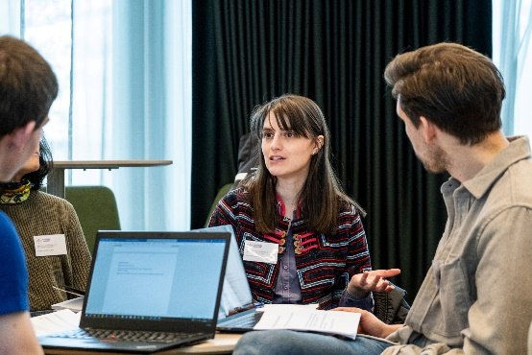
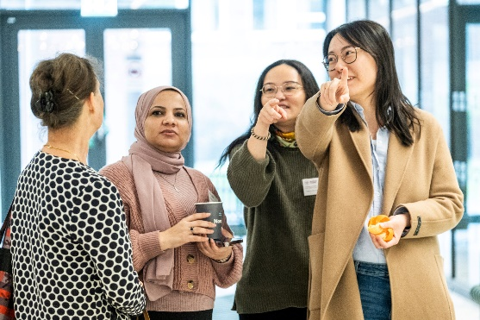
Doctoral programs at GPH
Public Health Science Programme (PHSP) - Determinants of health
- Disease and longevity
- Migration and health
- Health policy
- Health economics
- Survey design
- Socio-economic determinants
- Implications of aging
- Populations, quality assurance in Medicine and science, etc.
Biology of Infections and Global Health (BIGH) - Infection biology and global health
- Pharmacoepidemiology
- Sexual and reproductive health
- Qualitative research
- Clinical
- Molecular bacteriology
- Improving antibiotic use
Notes:
Activities: kappa seminars, seminar series, workshops, journal clubs, an annual lunch with PhD students, etc.

Slide 12
Research and education support
HR
Finance
Educational support
Secretariat and communication
Infrastructure
Notes:
Research and education support
The administration unit provides support to the department and our 12 research groups. The unit’s mission is to work in close collaboration with researchers, teachers and students, and to provide top class support. Efficiency, teamwork, and constant change are core values for the administration.
Educational administration
The educational administration supports teachers and students at undergraduate, advanced and doctoral level education. The study counsellor at the department supports our students at undergraduate and advanced level with study related issues.
Human Resources
Our HR team handles employments, affiliations, compensations and benefits, as well as work environment issues.
Finance
The finance team is responsible for legal accounting, supplier invoices and expense reports, but the team also supports researchers in financial budgeting, monitoring, and the reporting of research projects.
Secretariat and communication
The secretariat offers administrative support to the Head of Department. Internal and external communication, as well as managing our website, is another important task. Our department grant writer offers hands-on support regarding grants applications.
Infrastructure
Our department technician deals with the infrastructure matters regarding internal mail, deliveries, phone tasks and some IT-related issues.

Slide 13
Network and centers
WHO Collaborating Centre on Tuberculosis and Social Medicine
WHO Collaborating Centre for Research and Training on Health Care and Public Health in Disasters
KI Centre for Tuberculosis research
CESH
Centre for Health Crisis
CHESS (Stockholm University and KI)

Slide 14
Funds that enable the activities of the GPH
Government funding
education 8%
Government funding
research 14%
External
funding
78%

Slide 15
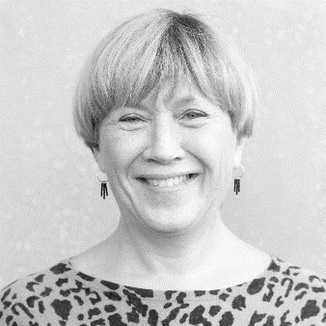
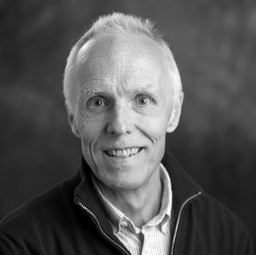
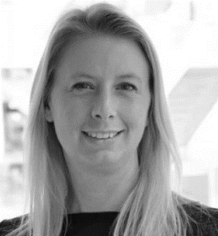
GPH Management
Marie Hasselberg, Head of Department
Bo Burström,
Acting Head of Department
Therese Lind,
Head of Administration

Slide 16
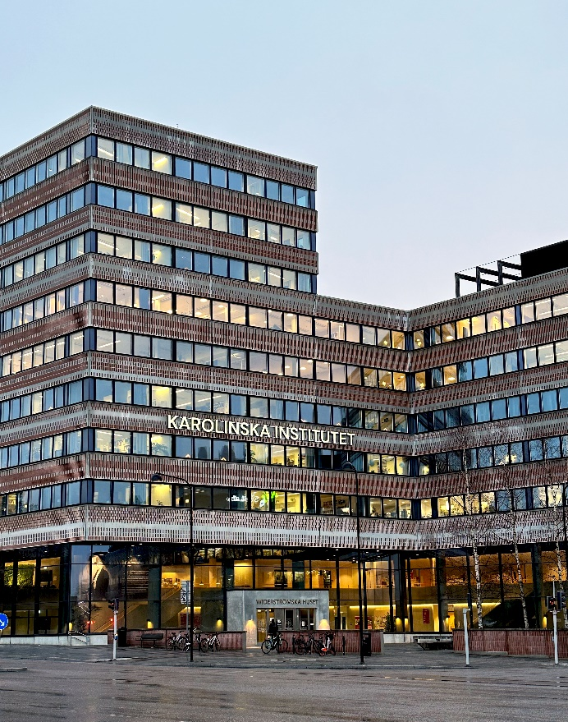
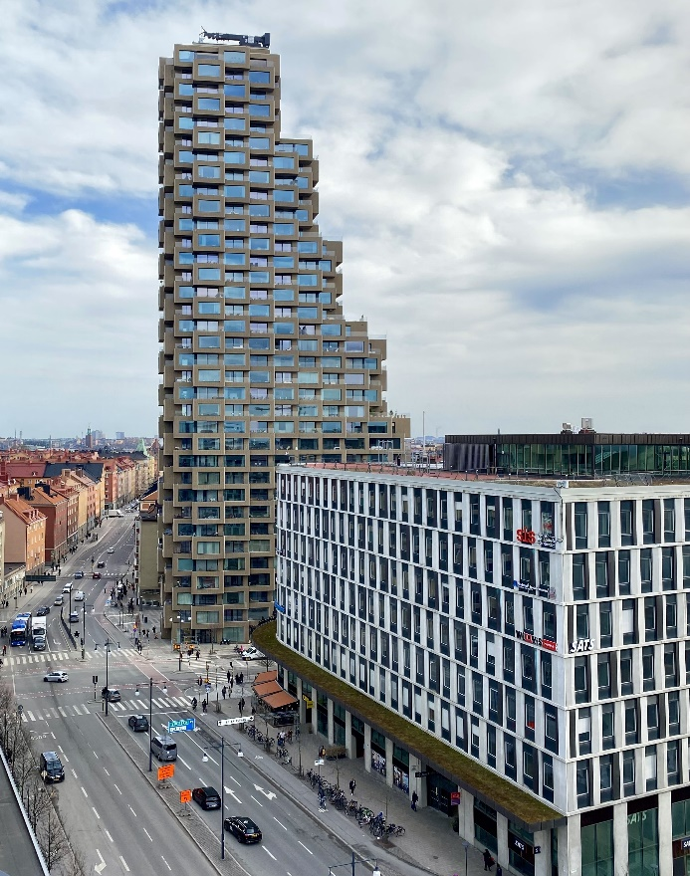
Welcome to visit us at GPH!
Widerström building
Torsplan
Notes:
The Department of Global Public Health has two visiting addresses:
Tomtebodavägen 18A, in the Widerström building at Campus Solna and
Solnavägen 1E, Torsplan, Stockholm

Slide 17
ki.se

