Slide 1
Seed Funding for Local WISE Groups
Dhifaf Sarhan, Senior Lecturer/Associate Professor
Head of Division, LABMED, Division of Pathology
WISE- Senior leader

Slide 2
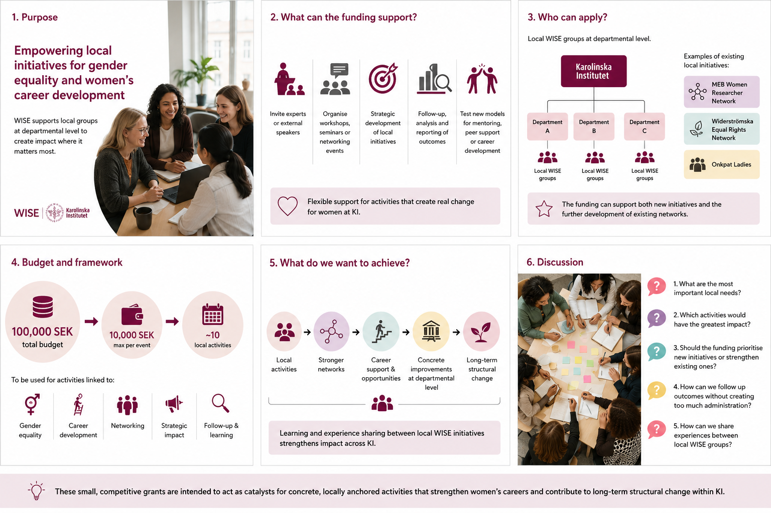
Purpose
WISE aims to support local initiatives that strengthen gender equality and women’s career development at departmental level
The purpose of this funding is to enable concrete activities, strategic development, and follow-up of local initiatives

Slide 3
What can the funding support?
Inviting experts or external speakers
Organising workshops seminars, or networking events
Strategic development of local initiatives
Follow-up analysis, and reporting of outcomes
Testing new models for mentoring, peer support, or career development

Slide 4
Who can apply?
Local WISE groups at departmental level
Examples of existing local initiatives include:
MEB Women Researcher Network
Widerströmska Equal Rights Network
Onkpat Ladies
The funding can support both new initiatives and the further development of already existing networks

Slide 5
Budget and framework
Total budget: SEK 100,000
The funding should be used for activities clearly linked to:
gender equality career developmentnet working
strategic impact follow-up and learning

Slide 6

What do we want to achieve?
The aim is to enable local groups to create activities that lead to:
stronger networks for women
increased visibility
better support during career transitions
concrete improvements at departmental level
exchange of experience between local WISE initiatives

Slide 7
Discussion questions
What are the most important local needs?
Which activities would have the greatest impact?
Should the funding prioritise new initiatives or strengthen existing ones?
How can we follow up outcomes without creating too much administration?
How can we share experiences between local WISE groups?

Slide 9
Avslutningsbild med Karolinska Institutets logotyp

