Slide 1
Karolinska Institutet
A medical university
Notes:
A general presentation about KI

Slide 2
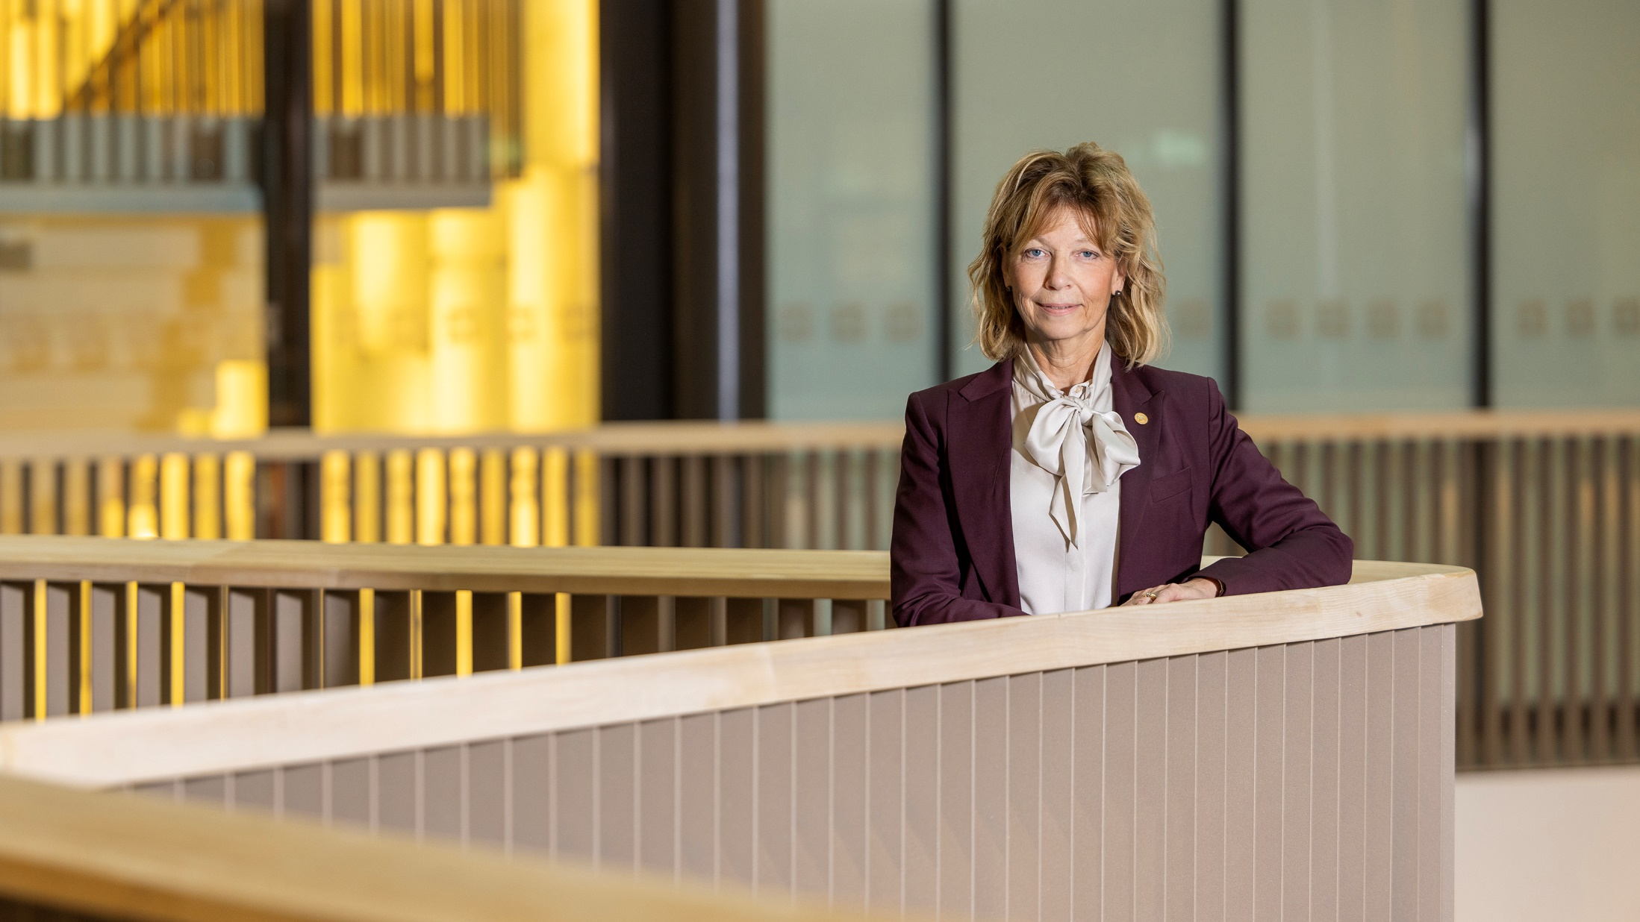

Welcome to Karolinska Institutet
At KI, you will find opportunities to embark on a lifelong career in academia, in healthcare, or in the life sciences sector.
Annika Östman Wernerson
President, Karolinska Institutet
Photo: Liza Simonsson

Slide 3

Value Statements
Three parts:
Magna Charta Universitatum, The
Ethical Foundations of the State and Karolinska Institutet’s own core values:
l creativity l passion l responsibility
Photo: Pixabay
Notes:
Our core values should permeate our culture and serve as a guideline for how we are perceived and how we tackle the challenges that arise in our operations. Our core values shall be reflected in the organisation's governance and standards and guide us in an environment where the conditions for our operations are constantly changing. This is crucial for making the right choices and taking long-term, sustainable decisions.
KI’s core values are:
Creativity - We create groundbreaking results through creative thinking, perseverance, collaboration, and encouragement of originality
Passion - We have a passion for science and knowledge transfer, and their power to change the world
Responsibility - Our activities are characterised by high quality and an ethical approach, as well as by respect, empathy, and critical reflection.

Slide 4
Our vision.
We are advancing knowledge about life and strive towards better health for all.
Notes:
The vision is shared by everyone who works at KI and describes what we do and what we aim to contribute in a concise sentence.
KI’s vision:
We are advancing knowledge about life and strive towards better health for all.

Slide 5

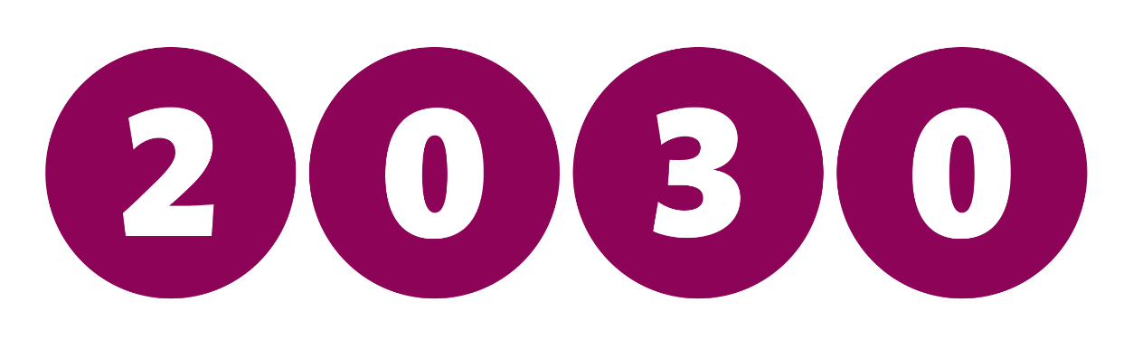
KI’s strategic plan Strategy 2030
Creating Karolinska Institutet’s
future together
Notes:
Background to Strategy 2030
Ongoing long-term change work. Organisational and infrastructural changes. New management organisation since the turn of the year 2018/2019. About 80 per cent of our experimental research has moved into new premises. Through Strategy 2030, we are setting out the direction for KI for the next ten years or so.
We will approach 2030 as a groundbreaking, collaborative and global university. These three strategic choices are the most important for us to achieve our overall goals and move closer to our vision: “We are advancing knowledge about life and strive towards better health for all”.
The strategic choices are interdependent: By strengthening our international profile – a global university – and our collaboration with healthcare, higher education institutions and others – a collaborative university – we gain the perspectives we need to make new breakthroughs in research and achieve high quality in education – a groundbreaking university.
Taking responsibility for the development of society. The strategic choices involve broadening our ambitions and taking greater responsibility for the development of society globally, nationally and locally.

Slide 6
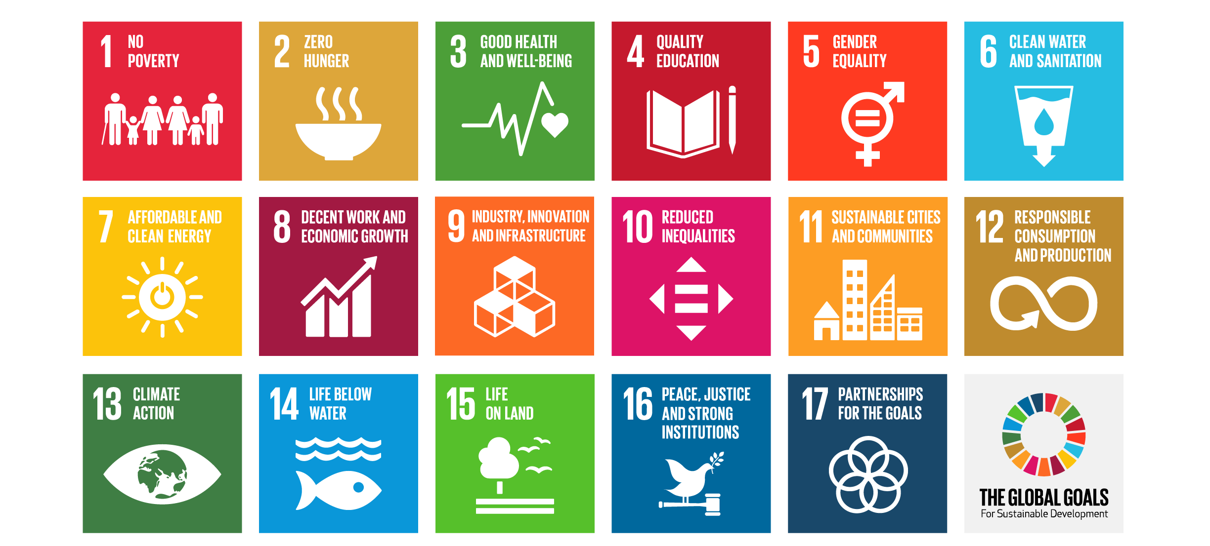
The Global Goals
Notes:
The Global Goals are the most ambitious agenda for sustainable development that the nations of the world have ever adopted and exists to achieve four fantastic things by the year 2030:
To eliminate extreme poverty.
To reduce inequality and injustice in the world.
To promote peace and justice.
To solve the climate crisis.
KI’s activity should be inspired by and contribute to the UN’s 2030 Agenda and the 17 global goals for sustainable development – Sustainable Development Goals (SDGs). We have the greatest opportunity to contribute to a better environment and sustainable development by increasing visibility and integrating a sustainability perspective in our research and education. Education, research, innovation and leadership are essential for society’s sustainable development.

Slide 7
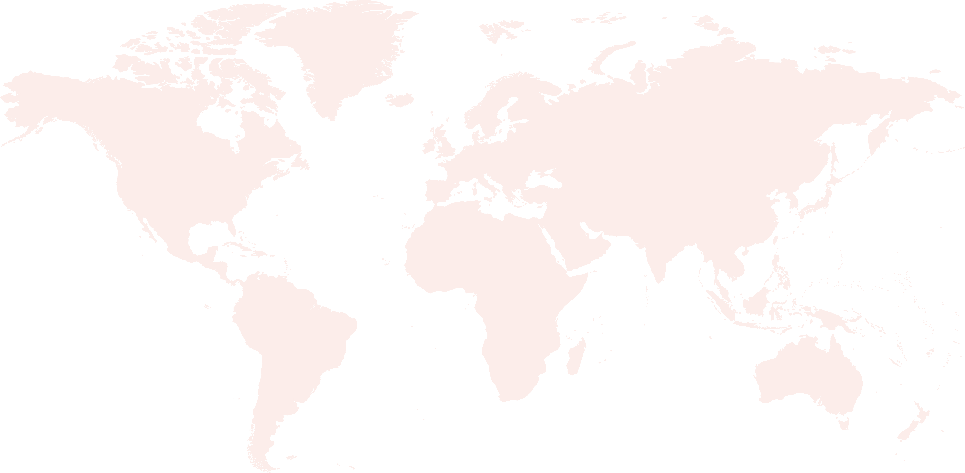
International co-publications
75 %
Scientific articles
co-published with parties
outside of Sweden
Graphic: datamaps.world
Notes:
International co-publications 2023-2025
The number of academic articles published by KI’s researchers in collaboration with one or more researchers from different parts of the world.
Every year, KI's researchers publish many scientific articles in collaboration with researchers in other countries. In recent years, international co-publications have accounted for about 75 percent of all articles from KI. During the period 2023–2025, articles were published together with researchers based in approximately 180 different countries. The country with the most co-publications was the United States, closely followed by Great Britain and Germany.
(Annual Report 2025, page 39)

Slide 8
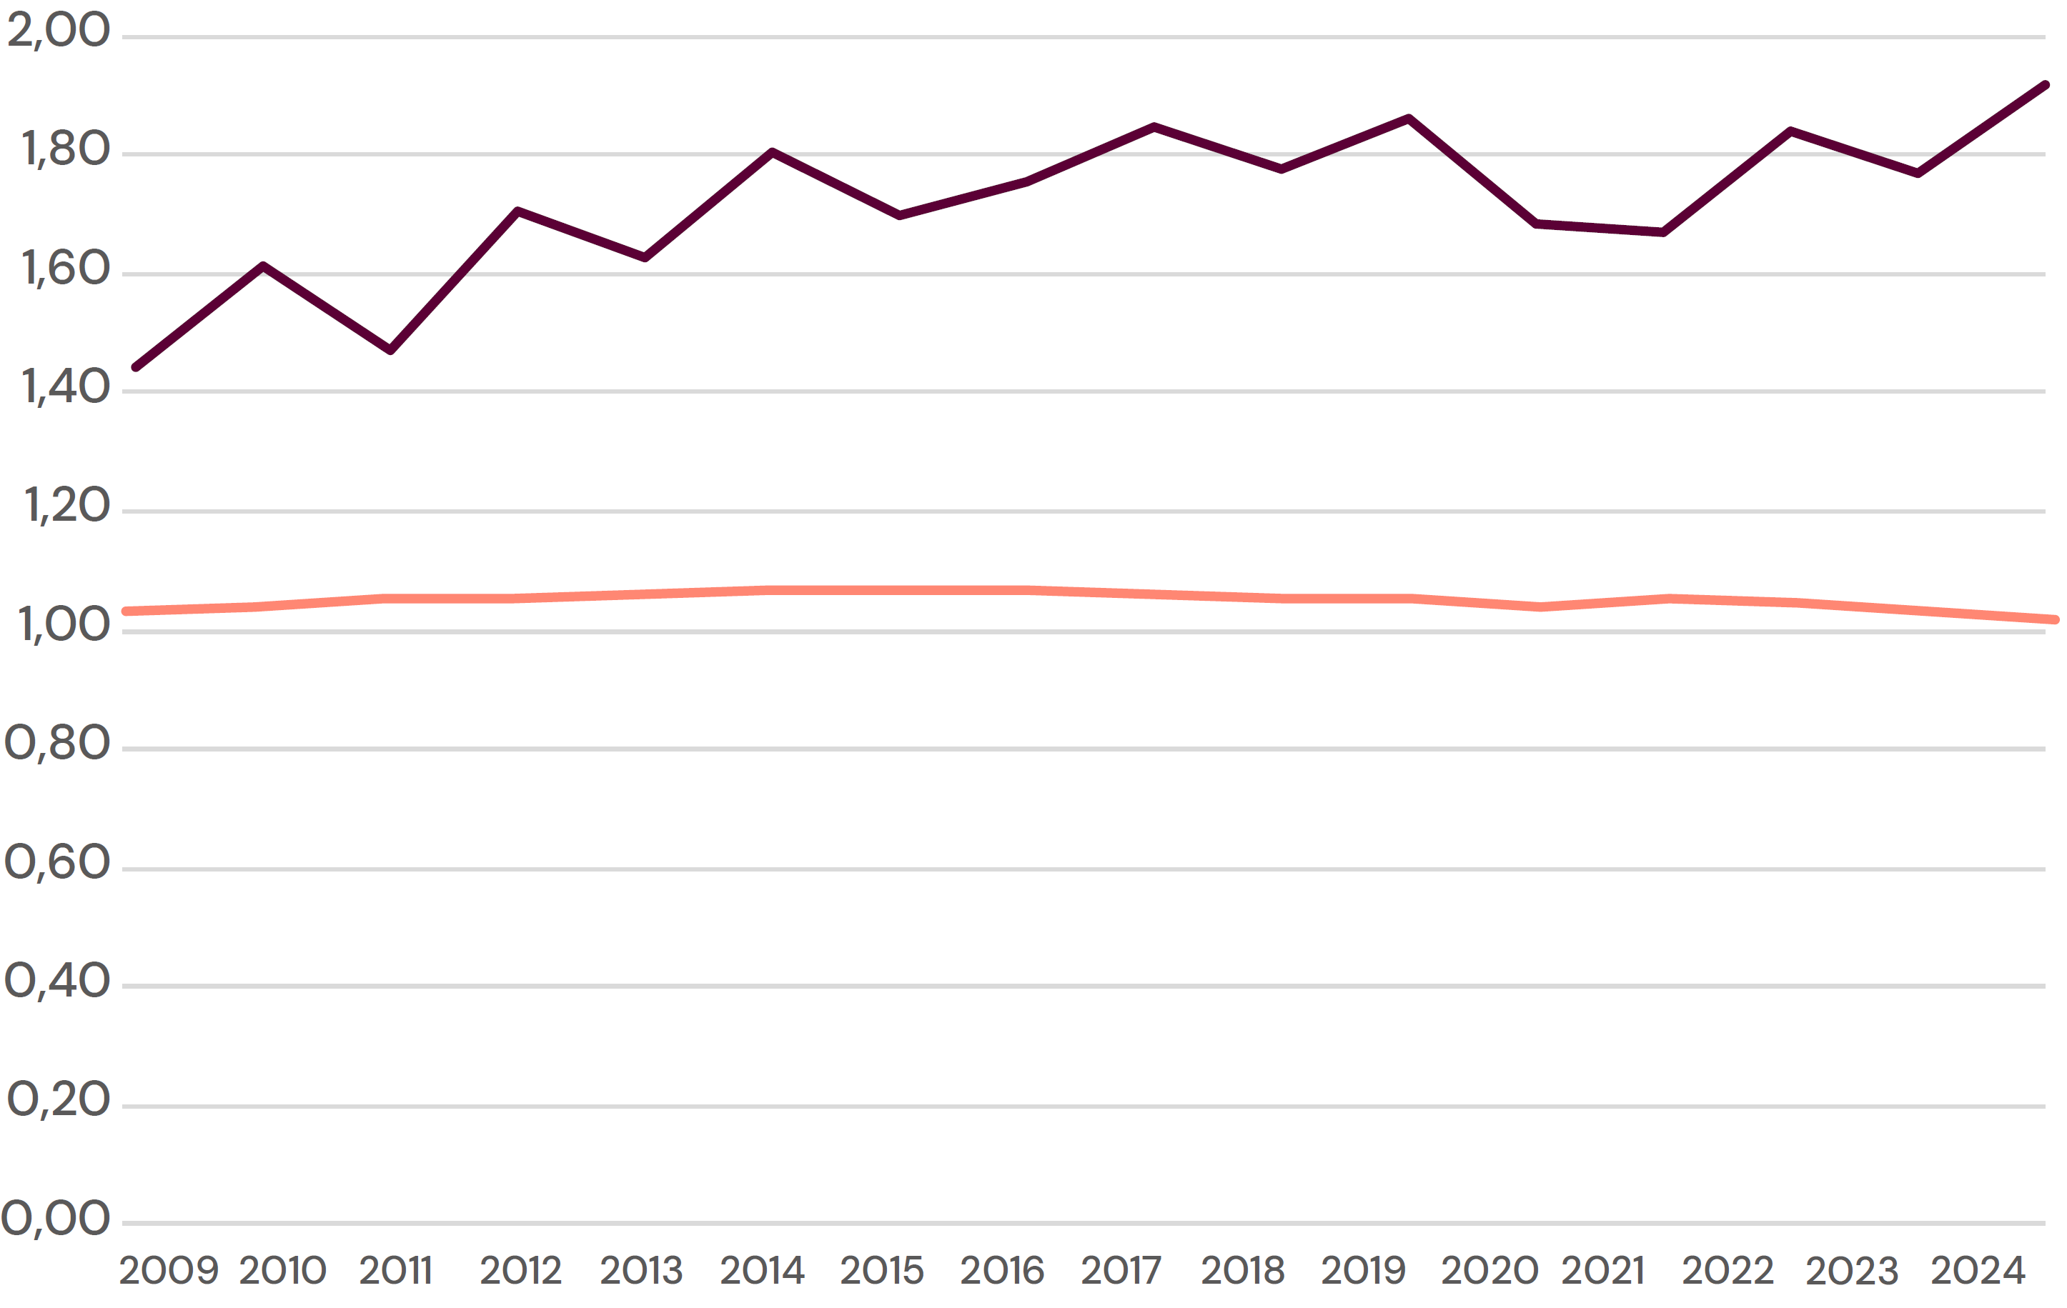
Field-normalised citation score
Field-normalised citation score
EU27 and Great Britain
Indikatorer av typen fältnormerad citeringsgrad kräver en viss volym på publikationer och citeringar för att bli statistiskt signifikanta. Publikationer från 2025 har ännu fått relativt få citeringar och kan därför inte anses utgöra stabila och tillförlitliga resultat och har därför exkluderats från ovanstående figur. Certain data included herein are derived from the© Web of Science 2026 of Clarivate Analytics (UK) Ltd. All rights reserved. No part of these materials may be reproduced, stored in a retrieval system or transmitted in any form or by any means, including electronic, mechanical, photographic, magnetic or other means without the express permission of Karolinska Institutet University Library.
Notes:
The field-standardized citation rate reflects an article's citation rate in relation to the citation rate of comparable publications, i.e. publications of the same document type, published in the same year and within the same subject. The diagram shows the average value per year of the field-standardized citation rate for all articles from KI. This is set in the diagram in relation to the corresponding Cf value for the EU's 27 member states (EU27) and Great Britain. KI's citation rate is at a level that exceeds the corresponding value for the EU27 and Great Britain.
(Annual Report 2025, page 38)

Slide 9

The Nobel Prize in Physiology or Medicine
At a time when truth itself is increasingly questioned, many
find inspiration in prizes that celebrate scientific discovery.
Thomas Perlmann
Secretary-General of the Nobel Assembly and
Nobel Committee for Physiology or Medicine at
Karolinska Institutet.
Photo: Erik Flyg
Notes:
The Nobel Assembly at Karolinska Institutet, which selects the Nobel Prize winners in physiology or medicine, consists of 50 elected members who are professors at KI. Through its work with the Nobel Prize, KI has gained an invaluable network of contacts and a unique overview of medical research findings around the world.
Quick facts about the Nobel Prize in Physiology or Medicine
The prize was established by Alfred Nobel in his will of 1895 and was first awarded in 1901.
As of 2024, the prize sum is SEK 11 million for each Nobel Prize, which can be divided between several, although no more than three laureates.
The building in which the Nobel Assembly meets is called the Nobel Forum and is located on Karolinska Institutet’s Campus Solna.
The final vote takes place immediately before the winner or winners are made public, on the first Monday of October each year. The decision cannot be appealed.
The winner or winners will be notified just before the announcement is made public.
Alfred Nobel invented dynamite. He built up an expanding business empire but had no close family. In his final will he left the greater part of his wealth to a fund, the interest on which was to be distributed annually as the Nobel Prizes.
Of the eight Swedes who have won the Nobel Prize in Physiology or Medicine to date, five are from Karolinska Institutet.
The Nobel Prize medal is handmade from 18-carat recycled gold and weighs 175 grams.

Slide 10
KI in numbers
Full-time equivalent students
6,743 (6,483)
Degrees
2,587 (2,860)
73 %
Women
27 %
Men
Doctoral students
2,215 (2,230)
Doctoral Degrees (PhD)
347 (341)
62 %
Women
38 %
Men
Notes:
Annual Report 2025 (comparative figures for 2023 are shown in parentheses)
However, the figures for the number of students and doctoral students are not completely comparable. "Full-time equivalent students" are not individuals but a measure of educational volume (roughly: if we combine all registered students/individuals on different courses and programs who study different number of credits to full-year students, we get this figure), the number of reported "doctoral students" here is however individuals.

Slide 11
Revenue
8.7
SEK billion
in revenue
Notes:
Revenue Karolinska Institutet 2025: a total of SEK 8 650,1 million
Divided into
Direct government funding 41 %
Research councils 13 %
Other government agencies 6 %
Municipalities and county councils 5 %
Swedish foundations and organisations 19 %
Foreign foundations and organisations 9 %
Swedish companies 2 %
Foreign companies 2 %
Financial income 3 %
(Annual Report 2025, page 60)

Slide 12
External research funding
10 largest external research funding sources in total 2023-2025, SEK million
(excluding asset management)
Function | 2023 | 2024 | 2025 | Change 2024-2025
The Swedish Research Council | 979 | 964 | 893 | -7 %
European Union | 296 | 366 | 394 | 8 %
The Swedish Cancer Society | 326 | 336 | 353 | 5 %
The Wallenberg Foundations | 207 | 241 | 201 | -17 %
Forte | 161 | 165 | 184 | 12 %
Royal Institute of Technology | 120 | 124 | 116 | -6 %
The Swedish Heart Lung Foundation | 85 | 118 | 115 | 4 %
The Swedish Childhood Cancer Fund | 142 | 111 | 100 | -15 %
Stockholm County Council | 94 | 89 | 97 | 9 %
KI - Foundations | 38 | 55 | 69 | 25 %
Other | 1,238 | 1,298 | 1,284 | -1 %
Total | 3,686 | 3,867 | 3,805 | -2 %
Source: Unit4 ERP
Notes:
(Annual Report 2025, page 33)

Slide 13
EU
394
SEK million in revenue
from the EU
237
EU-funded projects
52
ERC projects
Including scholarships and
other transfers
In 2025, KI had a total of 237
ongoing EU-funded projects
At the end of 2025, KI
participated in 52 European
Research Council (ERC) projects
Notes:
(Annual Report 2025, page 34)

Slide 14
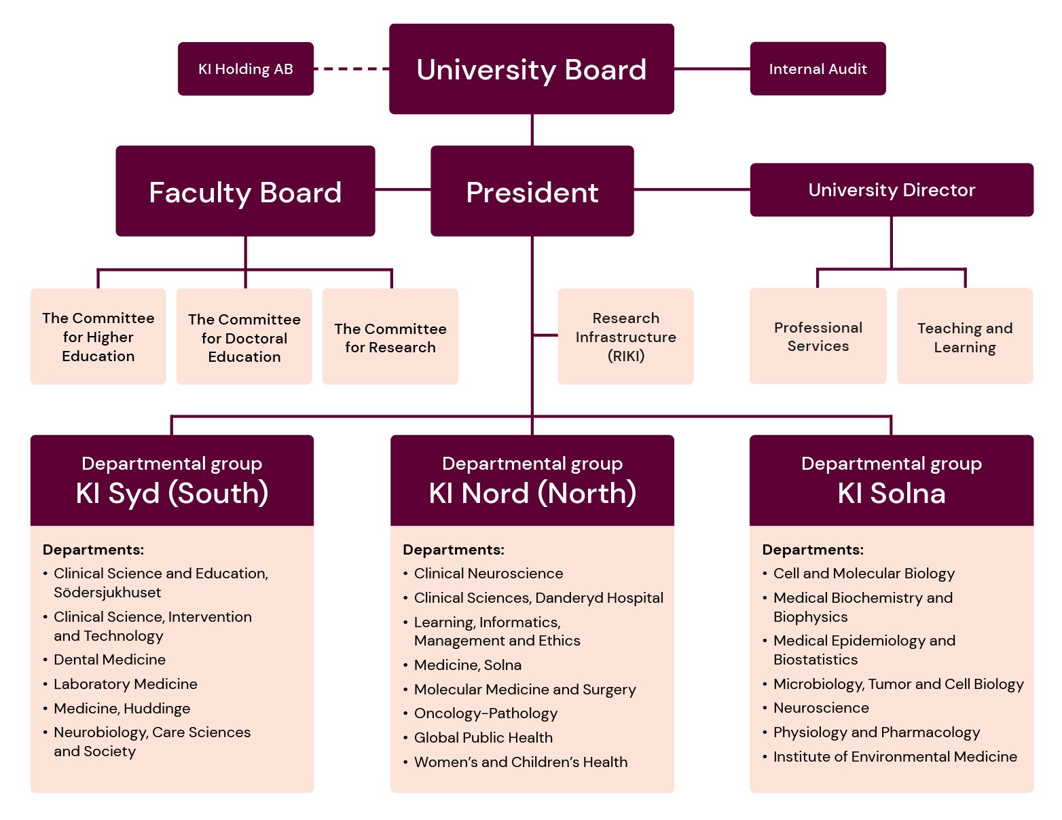
Organisational chart
Notes:
How KI is organized:
The Board of Karolinska Institutet (Konsistoriet) is the university’s highest decision-making body.
Internal audit is an independent function working on behalf of the University Board to examine conformity with the requirements concerning operational efficiency, the management of central government funds, financial reporting and regulatory compliance.
The President is the government-appointed director general of KI, and presides over the university under the University Board. The Vice President is the President's deputy and has delegated responsibility for specific areas of assignment.
The Faculty Board operates under the president and has overall responsibility for education and research.
The Faculty Board comprises three committees that prepare and examine issues of concern to their particular field of activity. The committees also are delegated by the Faculty Board to make decisions on certain matters. The three committees are:
The Committee for Higher Education,
The Committee for Doctoral Education
The Committee for Research
Supporting the President’s strategic work is a Faculty Council, which guides on issues related to research and education at KI.
RIKI will be established as a new organisational unit at KI to bring together KI's core-facilities in a cohesive research infrastructure.
KI’s core activities of research and education are conducted by 21 departments organised into three departmental groups:
KI North, KI Solna and KI South
Each departmental group is led by a Dean, who also forms part of the President’s management group.
KI has various research centres, each concentrating on a particular research field.
The university management includes a University Director with overall responsibility for KI’s Professional Services and its eight offices, including The KI University Library
The heads of the following units report to the University Director: Teaching and Learning.
Karolinska Institutet Holding AB is a government-owned company managed by KI.

Slide 15
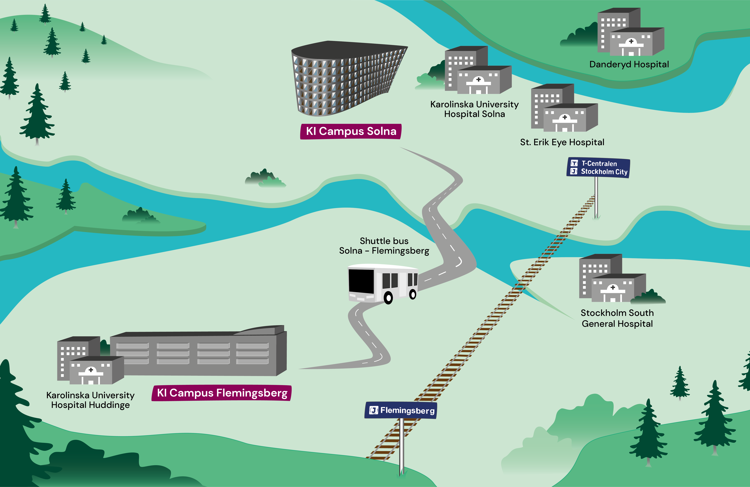
Geographic location
Education and research at Karolinska Institutet is mainly conducted on two campus areas: campus Solna and campus Flemingsberg.
In addition to the campus
areas, there are several hospitals that are closely connected to KI's educations.
Graphic: Arkitektkopia
Notes:
The campus areas are in Solna and Huddinge municipality, which are neighbouring municipalities to Stockholm. Solna is located northwest of Stockholm and Flemingsberg in Huddinge in the south. In addition to the campus areas, which are adjacent to the university hospital, there are also several hospitals that are closely linked to KI's programs and activities: Danderyds Hospital, Södersjukhuset (South Hospital) and S:t Erik's Eye Hospital.

Slide 16


Equal Opportunities at KI
Equal rights and opportunities for all.
Important to provide an inclusive work and
study environment in which all students and
co-workers are treated with respect.
Photo: Erik Flyg
Notes:
KI's work for equal opportunities means that no one should be discriminated against or harassed because of gender, transgender identity or expression, ethnicity, religion or other belief, disability, sexual orientation or age.
For KI it is important to provide an inclusive work and study environment in which all students and co-workers are treated with respect and where the conditions are excellent for working and developing. KI’s activities shall be characterised by a good physical, organisational, and social study and work environment that is free from discrimination, offensive behaviour, and harassment.

Slide 17


Education
13 undergraduate (first cycle)
programmes
31 postgraduate (second cycle) programmes
Sweden’s widest range of education in medicine and health sciences.
Photo: Erik Flyg
110 freestanding courses
Notes:
One of the world’s leading medical universities
KI offers the widest range of education in medicine and health sciences under one roof in Sweden. Approximately 6,500 full-time students (11,000 in total) are taking educational and single subject courses at Bachelor’s and Master’s levels at KI.
The proximity of the Karolinska University Hospital and other teaching hospitals in the Stockholm area plays an important role during the education. Several of the programmes include clinical training or other training within the healthcare system.
Most of the educations lead to a vocational degree and several of the educations also lead to a general degree.
5 reasons to choose KI
The latest in medical research At KI, teachers often engage in research along-side their teaching responsibilities. This allows students to stay updated on the most recent advancements in the medical field.
Interprofessional learning Students learn to collaborate with peers from various healthcare disciplines, preparing them to work effectively in multidisciplinary teams, enhance patient care, and improve health outcomes.
Active student life KI boasts a vibrant student life, supported by two student unions that organise a variety of activities, including sports events, theatre groups, themed parties, and much more.
Health matters At KI the students well-being matters. KI offers free access to well-equipped campus gyms, group activites, and individual counselling services.
International study environment KI is an international university, welcoming students from around the globe, which enriches the educational experience.

Slide 18

Global Bachelor's and Master’s Programmes
Bachelor’s Programme in
Biomedicine
Joint Master's Programme in
Health Informatics
Biostatistics and
Data Science
Erasmus Mundus Public Health in Disasters
Molecular Techniques
in Life Science
Master's Programme in
Bioentrepreneurship
Biomedicine
Global Health
Health Economics, Policy and Management
Nutrition Science
Public Health Sciences
Toxicology
Translational Physiology and Pharmacology
All programmes are taught in English.
Photo: Erik Flyg
Notes:
KI offers the widest range of medical education in Sweden and ranks among the top universities in the world.
A master's degree from KI will give you an advantage on the global job market and prepare you for PhD studies.
KI offers the following bachelor’s and master’s programmes
- all programmes are taught in English:
Bachelor's Programme in Biomedicine
Joint Master's Programme in Health Informatics
Joint Master’s Programme in Biostatistics and Data Science
Joint Master’s Programme in Erasmus Mundus Public Health in Disasters
Joint Master's Programme in Molecular Techniques in Life Science
Master's Programme in Bioentrepreneurship
Master's Programme in Biomedicine
Master's Programme in Global Health
Master's Programme in Health Economics, Policy and Management
Master's Programme in Nutrition Science
Master's Programme in Public Health Sciences
Master's Programme in Toxicology
Master's Programme in Translational Physiology and Pharmacology

Slide 19
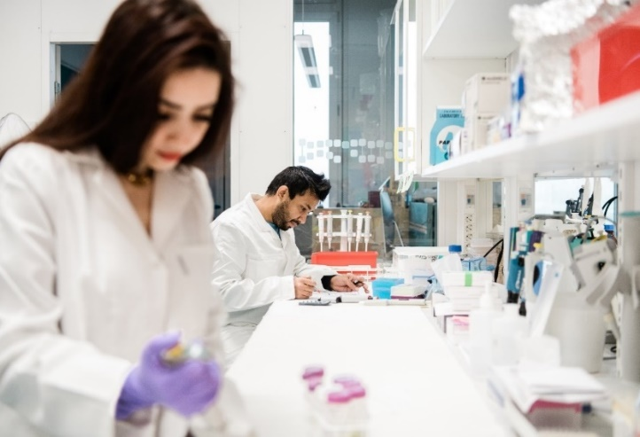


Doctoral Education
33 %
of all the doctoral students in Medicine and Health Sciences
in Sweden, are at KI
The doctoral student develops
knowledge and understanding while carrying out a research project in close interaction with experienced supervisors.
Photo: Erik Cronberg
Notes:
Over 2,000 doctoral students in medicine and health sciences are at KI, constituting 33 % of all doctoral students in the area in Sweden (statistics from UKÄ).
Every year, around 350 students obtain their doctoral degree (PhD) at KI. Many of these have completed their undergraduate or master’s level education abroad.
Available doctoral positions span the entire field of medical science, from cell to society, and are announced continuously so that interested candidates may apply for them.
In the 2023 analysis, it was found that KI's postgraduate education generally maintains a high quality, and that the development areas that exist are largely about further implementing the tools and routines that already exist.
Being a doctoral student means being part of a group of researchers that conducts research in close interaction with dedicated supervisors. The doctoral student develops knowledge and understanding while carrying out a research project in close interaction with experienced supervisors.
As a complement to this “learning-by-doing” structure, students also participate in courses and other learning activities that enable them to obtain their degree.
International collaboration raises the quality of education and creates opportunities for our students to connect with other research environments.
At the conferment ceremony, the new Doctors of Medical Science receive their traditional doctoral hats and diplomas at Stockholm City Hall. Stockholm City Hall is also the location for the Nobel Banquet in Stockholm.

Slide 20
Doctoral Education cont.
Individual
Study plan (isp) established
Half time control
Isp
follow up
After 4 years:
Public defence
Phd
Isp
follow up
Isp
follow up
Admission
Research under supervision + courses and learning activities
Target achievement
Notes:
A doctoral education lasts four years and leads to a doctoral degree in medical science.
Doctoral studies are characterised by individuality, with a high degree of freedom and many opportunities.
Each doctoral student has an individual study plan, developed in collaboration between the doctoral student and their supervisor, which describes how the degree requirements will be met for that particular doctoral student.
The majority of the programme consists of the doctoral student carrying out an individual research project in collaboration with their supervisors and other researchers. ‘Learning by doing’.
The projects cover all the different research areas at KI, from cells to society.
There is a wide range of courses, seminars and other learning activities aimed at doctoral students.

Slide 21
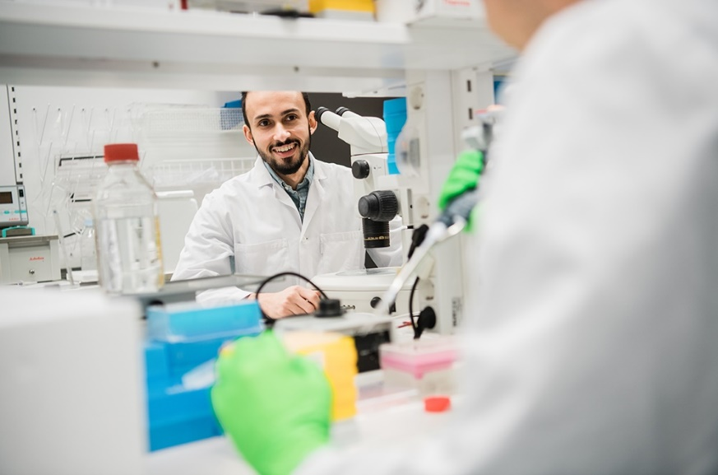
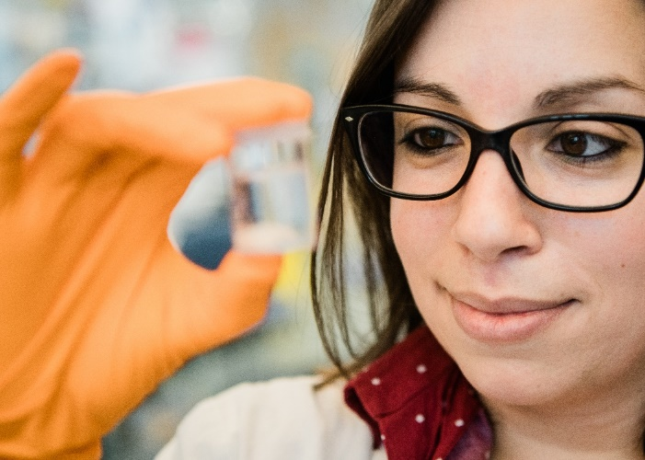
Research
From basic molecular biological research to clinical epidemiology and care sciences.
Photo: Erik Cronberg. Source: Web of Science and Medline.
7,200
Number of publications
(Articles och reviews)
Notes:
Clinic-based research facilitates the swift transfer of experimental findings to patient benefit, and clinical observations provide the basis for new research ideas.
KI accounts for the single largest share of all academic medical research conducted in Sweden. Our research spans the entire medical field, from basic experimental research to patient-oriented sciences and global health – and can be described in nine overall research areas.
Over the past year, KI researchers have published approximately 7,200 scientific articles (articles + reviews). Of these articles, just over 90 per cent have been published in collaboration with other actors outside the university, in Sweden and abroad. A large proportion of the published research has some connection to healthcare; see clinical research for more information. Many of the scientific articles are also included as part of the doctoral theses presented at KI.
(Annual Report 2024, page 37)

Slide 22
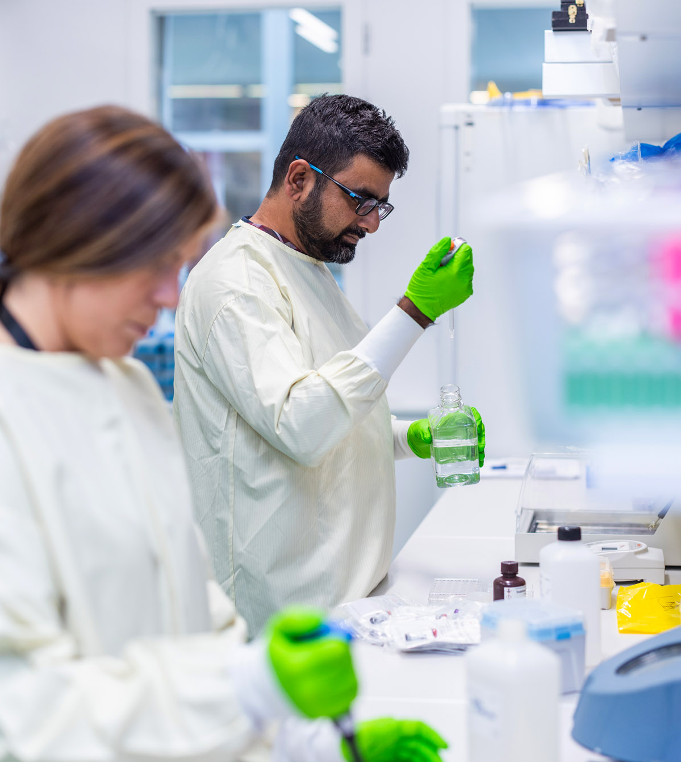
Research at KI
Health and disease throughout all stages of life
The world around us – global health and
international collaboration
The future of healthcare – precision medicine,
ATMP, AI, and prevention
Cancer and immunology – better diagnostic tools and treatments
Brain, nervous system, and mental health
Registry research, epidemiology, and biostatistics
Curiosity-driven basic research on the body’s smallest components
Photo: Liza Simonsson
Notes:
Karolinska Institutet accounts for the single largest share of all academic medical research conducted in Sweden. The research spans the entire biomedical field – from basic experimental research to clinical studies in collaboration with the health care system. Pioneering research is conducted here in, for example, cancer, neuroscience, immunology, epidemiology, nursing and global health.We are also a part of the special effort on strategic research areas (SFO) made by the Swedish government.
Research areas:
Health and disease throughout all stages of life
The world around us – global health and international collaboration
The future of healthcare – precision medicine, ATMP, AI, and prevention
Cancer and immunology – better diagnostic tools and treatments
Brain, nervous system, and mental health
Registry research, epidemiology, and biostatistics
Curiosity-driven basic research on the body’s smallest components

Slide 23

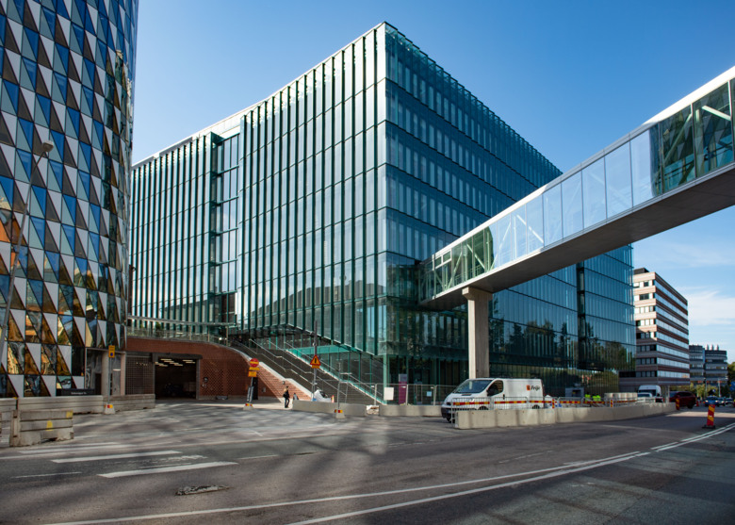

Research Infrastructure
New buildings for laboratories and a wide range of core-facilities offer advanced equipment, services and expertise for academic research in Sweden
Photo: Stefan Zimmerman, Martin Stenmark and SciLifeLab
Notes:
New laboratories and offices. During the last years, our two campuses in Solna and Flemingsberg have significantly expanded with new laboratories and offices. We have a large number of service laboratories, competence centres and equipment within inter alia imaging, biostatistics, biobanking, proteomics and genomics, and have a joint organisation for animal research. Researchers can receive administrative support to arrange conferences, seek funding and more.
The broad offering of core facilities, which offer advanced equipment, services and expertise for academic research in Sweden, is open to all researchers at KI, within other academic institutions and, to a limited extent, commercial enterprises.
SciLifeLab is a national centre for molecular biology with a focus on health and environmental research. SciLifeLab is a national resource run by Karolinska Institutet, KTH, Stockholm University and Uppsala University and collaborates with several other Swedish universities. Its objective is to build a strong research group around SciLifeLab through education and cooperation. SciLifeLab combines the best technical expertise with deep knowledge of translational medicine and molecular biology. This national resource is financed by state funding in contribution to strengthening research and innovation.

Slide 24
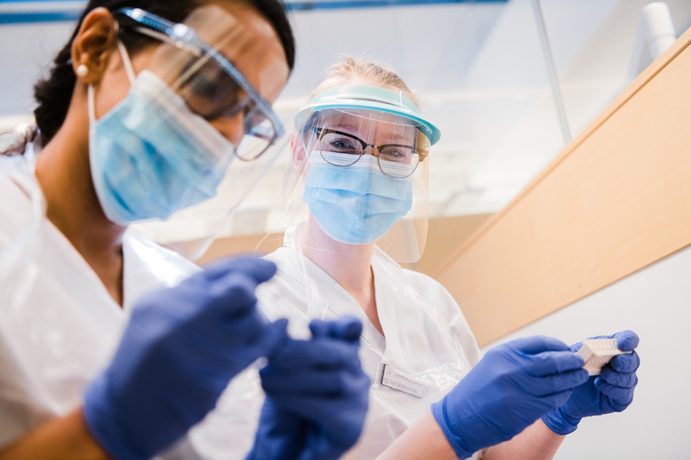

Collaboration
Close collaboration and innovation are an important part of the transition of knowledge and results to the community. Such transitions will promote better health and cure disease.
Photo: Erik Cronberg
Notes:
Close collaboration and innovation as an important part of the transition of knowledge and results to the community. Such transitions will promote better health and cure disease.
KI cooperates successfully with several different companies. Together we can deliver new services, products and knowledge that help improve human health.
International collaborations are crucial for KI to fulfil its mission and strive towards better health for all. Collaboration takes place at three levels through individual scientists' collaborations, departmental or centre collaborations with similar units at international higher education institutions, and finally through strategic alliances with leading international universities.
National life science strategy. KI has actively participated in the Swedish Government's work with a national life science strategy, and together with the Region Stockholm KI has initiated a regional life science strategy.
KI Alumni Network is a professional and social network for alumni and friends of Karolinska Institutet. KI's former students, researchers and employees constitute a vast network of experience and expertise with contacts around the world. KI Alumni strives to connect and maintain contact with alumni through news, events and valuable services.

Slide 25

Innovation and Entrepreneurship
Our ambition is to create the best possible conditions for the results
of our operations to be implemented in society and contribute to a healthier future for all.
Photo: iStock
Notes:
KI offers innovation support to researchers, students and employees. Our ambition is to create the best possible conditions for the results of our operations to be implemented in society and contribute to a better health for all.
Unit for Bioentrepreneurship, UBE, conducts research on and education in innovation and entrepreneurship. As an academic unit at KI, UBE can be considered as the first proactive link in KI: s innovation system.
Since 1995, KI Holding has been managing and managing large parts of KI's innovation system. KI Holding creates a prerequisite for KI to act commercially. This means that the company takes risks and can also make profits - unlike KI, which is a Governmental agency. The business is largely run by the wholly owned subsidiaries: Karolinska Institutet Innovations AB and Karolinska Institutet Science Park AB.
KI has long appreciated a dynamic interaction between academia and business - with benefits for society as a result. In order to evaluate, develop and commercialize interesting discoveries in life science and medical technology, a comprehensive innovation system has been created within the Karolinska Institutet - KI Innovations.
KI Innovations provides support and guidance for many of the ideas at KI that can contribute to a healthier future for everyone. At KI, world-leading research is being conducted, which constantly contributes to increased understanding of human health. KI Innovations helps researchers take the next step towards transforming their findings into socially beneficial products, methods and services, throughout the process from idea to innovation.

Slide 26
International ranking
Shanghai Ranking ARWU, 2025, GRAS 2025 | Overall (ARWU) | Clinical Medicine | Public Health | Dentistry and Oral health | Human Biological Sciences | Biological Sciences
World rank | 50 | 34 | 22 | 49 | 39 | 48
Europe rank | 15 | 10 | 6 | 16 | 10 | 10
EU rank | 7 | 3 | 2 | 7 | 3 | 5
Times Higher Education World University Rankings 2025/2026 (published 2025/2026) | Overall | Medical and Health | Life Sciences | Psychology
World rank | 53 | 12 | 29 | 34
Europe rank | 14 | 5 | 7 | 10
EU rank | 6 | 1 | 2 | 6
QS World University Rankings 2026 (published 2026) ¹ | Overall | Life Sciences and Medicine | Medicine | Pharmacy and Pharmacology | Dentistry | Nursing
World rank | N.A. | 11 | 10 | 15 | 1 | 16
Europe rank | N.A. | 6 | 5 | 6 | 1 | 5
EU rank | N.A. | 1 | 1 | 1 | 1 | 2
Updated 25 March 2026
¹ Only multi-faculty universities are qualified for QS overall ranking
Notes:
The table shows how KI is ranked in the world and in the EU (excluding the UK) according to Shanghai Ranking – ARWU, GRAS, Times Higher Education World University Rankings and QS World University Rankings.

Slide 27
International ranking
U.S. News & World Report
U.S. News & World Report Best Global Universities 2025-2026 (published 2025) | Overall | Biology and Biochemistry | Cell Biology | Clinical Medicine | Endocrinology and Metabolism | Immunology
World rank | 52 | 33 | 23 | 22 | 10 | 18
Europe rank | 14 | 9 | 5 | 5 | 4 | 4
EU rank | 7 | 4 | 2 | 2 | 2 | 2
U.S. News & World Report Best Global Universities 2025-2026 (published 2025) | Infectious diseases | Molecular Biology and Genetics | Neuroscience and Behavior | Gastro- enterology and Hepatology | Psychiatry / Psychology | Public, Environmental and Occupational Health
World rank | 36 | 24 | 15 | 25 | 13 | 14
Europe rank | 20 | 4 | 3 | 14 | 6 | 6
EU rank | 11 | 1 | 1 | 9 | 2 | 1
Updated 18 August 2025
Notes:
The table shows how KI is ranked in the world and in the EU (excluding the UK) according to US News & World Report Best Global Universities.

Slide 28
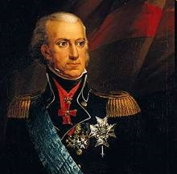
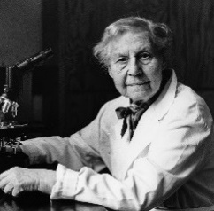
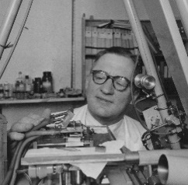




History
1810
KI is founded by King Karl XIII on
13 December 1810 as an "academy for the training of skilled army surgeons“.
1937
Nanna Svartz
is appointed professor at KI, becoming Sweden's first state-employed female professor.
1955
Hugo Theorell becomes KI's first Nobel Laureate, receiving the Nobel Prize in Physiology or Medicine.
1997
KI is granted official status
as a university.
2010
KI celebrates its 200th anniversary.
2019
Strategy 2030, the strategic plan that will be the guiding light until 2030 is decided.
Notes:
KI is founded by Kung Karl XIII on 13 December 1810 as an "academy for the training of skilled army surgeons“, Carolinska Medico Chirurgiska Institutet.
As one of KI's first professors, Jöns Jacob Berzelius lays the foundations of KI's scientific orientation, 1813.
Alfred Nobel's testament bequeaths KI the right to select the Nobel Prize in Physiology or Medicine, 1895 .
Nanna Svartz is appointed professor at Karolinska Institutet, becoming Sweden's first state-employed female professor, 1937.
Hugo Theorell becomes KI's first Nobel Laureate, receiving the Nobel Prize in Physiology or Medicine for his discoveries concerning the nature and mode of action of oxidation enzymes, 1955.
In 1997 KI is granted official status as a university, with a mission to "contribute to the improvement of human health through research, education and information".
KI celebrates its 200th anniversary in 2010.
Strategy 2030, the strategic plan that will be the guiding light until 2030 is decided, 2019.

Slide 29
ki.se
Notes:
Karolinska Institutet is one of the world’s leading medical universities. Our vision is to advance knowledge about life and strive towards better health for all. Karolinska Institutet accounts for the single largest share of all academic medical research conducted in Sweden and offers the country’s broadest range of education in medicine and health sciences. The Nobel Assembly at Karolinska Institutet selects the Nobel laureates in Physiology or Medicine.

